Slide 1
https://youtu.be/mVaS-gLi1Co

Slide 2
Concrete architecture of Bitcoin Core
Presenter:
Xueyi Jia
Jihong Zhang
Leader:
Jinlun Zhang

Slide 3
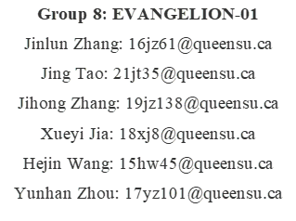
Contents Overview
Introduction
Derivation Process
Alternatives Architecture
Concrete Architecture / Reflection Analysis
Second-level subsystem with Reflection
Use case
Lesson Learnt /Limitation
Conclusion

Slide 4
Introduction
Conceptual Architecture (in A1)
What dependencies added/removed
Concrete Architecture
Intention of Reflection model

Slide 5
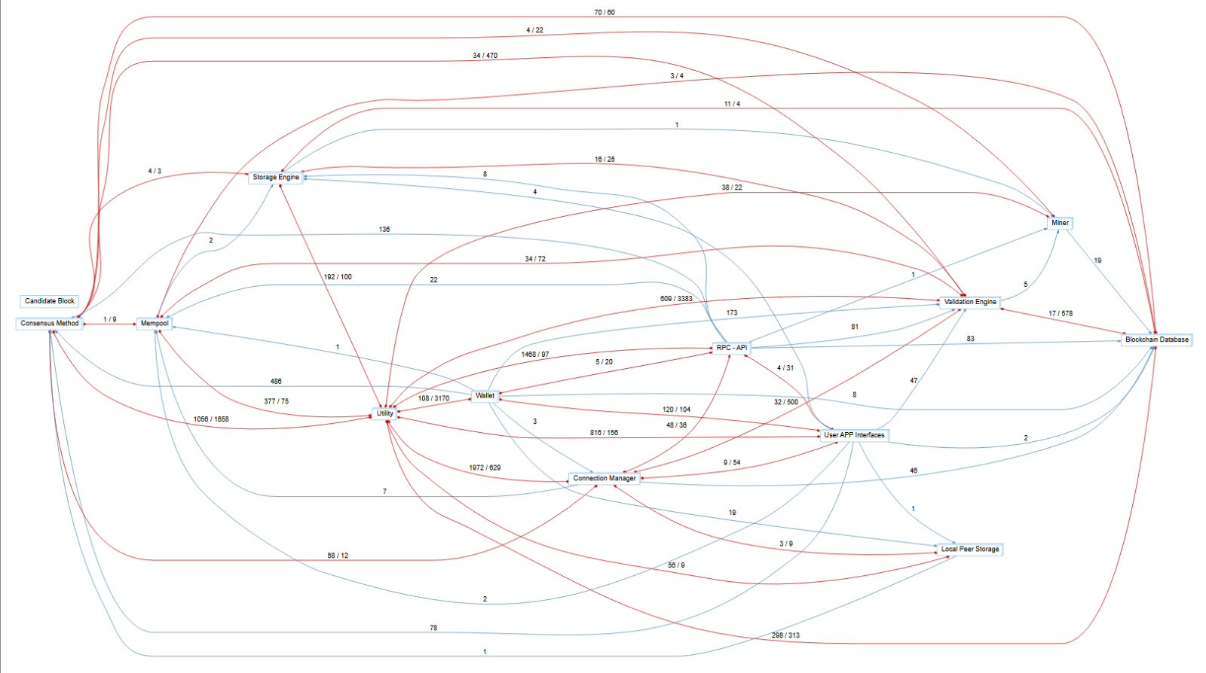
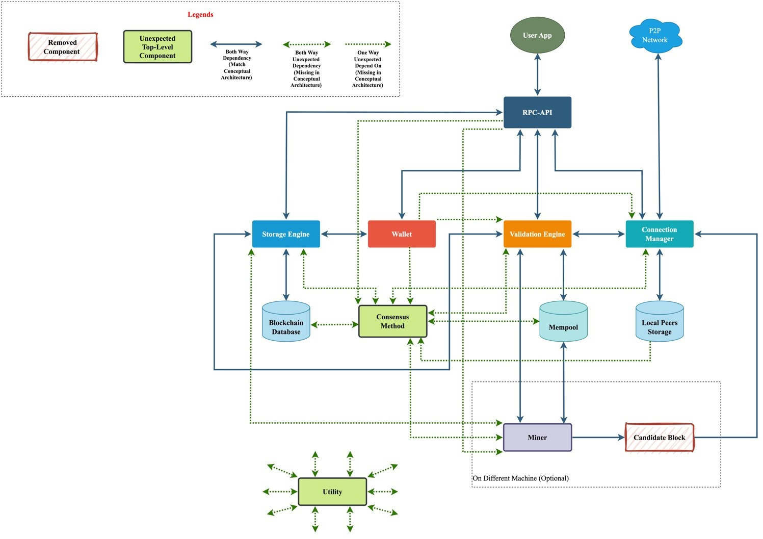
Derivation Process
(Mapping by Understand)
(Update Concrete Architecture)
Brainstorm -> Mapping by Understand -> Ideas Organization -> Make sketch

Slide 6
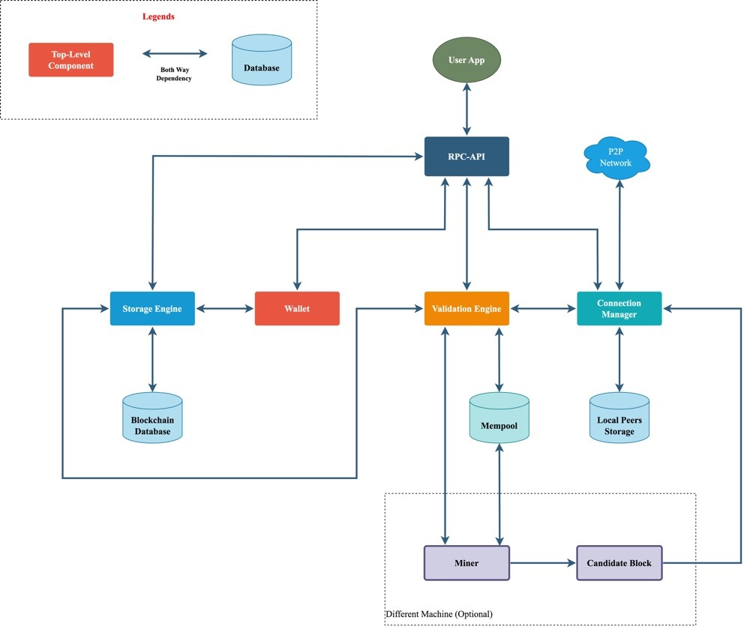
Alternatives Considered
Alternatives - Conceptual Architecture
Modify due to external knowledge
Repeated verification
Alternatives - Concrete Architecture
Rebuild model by Understand
Mapping Connections between subsystems
Add/Remove due to unexpected components

Slide 7
Reflection Analysis
Generally, through observing the clean concrete architecture shown on Understand, one can immediately notice the 2 unexpected top-level components, ‘Utility’ and ‘Consensus Method’. The Utility component in the cleaned concrete architecture stores a wide variety of files for the consistent and reliable deployment and execution of Bitcoin Core.

Slide 8

Conceptual Architecture Changed
Overview:
Client-and-Server style
New subsystems: ‘Utility’ and ‘Consensus Method’
Many new dependencies

Slide 9
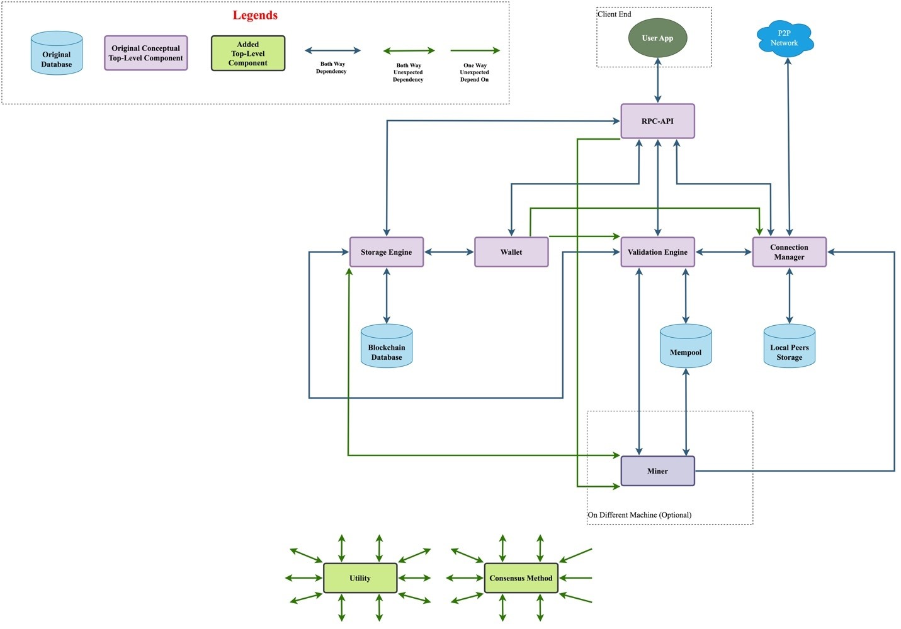
New dependencies:
RPC-API => Miner
Wallet => Validation Engine
Wallet => Connection Manager
Storage Engine <=> Miner

Slide 10
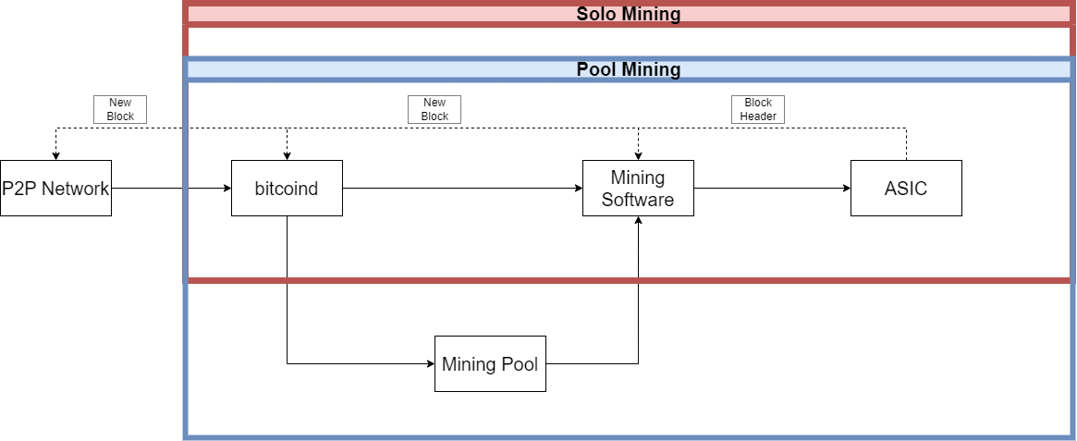
2nd-Level Subsystem
Conceptual Architecture of Mining
Component related to mining of blocks in conceptual architecture
Mining hardware
Mining software
Mining pools
Mining nodes
Networking and communication

Slide 11
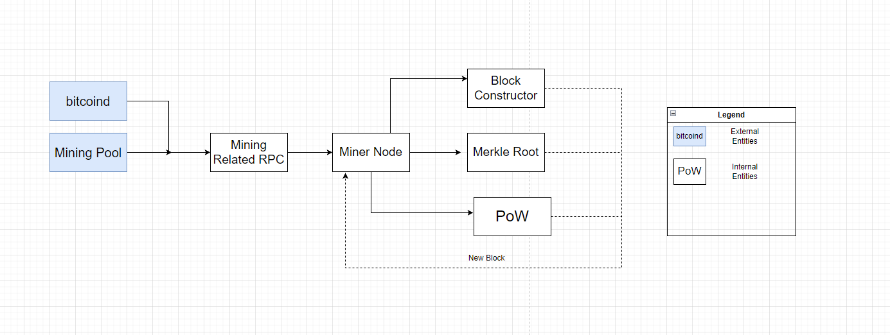
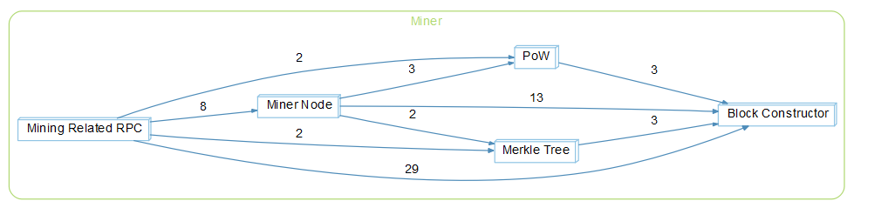
2nd-Level Subsystem of Reflection Analysis
Concrete Architecture of Mining
Component related to mining of blocks
Block Constructor
Proof of Work (Pow) Algorithm
Miner Node
Mining-related RPCs
Merkle Tree
Dependencies of Mining by Understand

Slide 12
Sequence Diagram
Use case of Mining

Slide 13
Lesson Learnt/Limitations
What we Learnt
Limitations
Differences between Conceptual and Concrete Architectures
Value of Scitools Understand
Importance of teamwork
Complexity and time-consuming nature of Scitools Understand.
Insufficient documentation in Bitcoin Core source code.
Redundant dependencies complicating Concrete Architecture analysis.

Slide 14
Conclusion
Identified the client-server architectural style as suitable for the Concrete Architecture.
Refined the Conceptual Architecture by studying developer documentation and using Scitools Understand.
Revealed new dependencies between subsystems through reflective analysis.
Removed some dependencies for testing and maintenance to clarify component relationships.
Gained a deeper understanding of Bitcoin Core's architecture, benefiting future research, development, and maintenance efforts.

Slide 15
Thank you

